Slide 1
Qr generator, reader and comparator
Digital Image Processing project
Yaiza Rubio Chavida
Fidan Rustambayli
Hugo Cortier

Slide 2
PROBLEM IT SOLVES
Control which people have entered to some place and at what time they did it.
Prevent people entering the rooms without belonging to the university.
Control people who have been together in some place. (COVID-19)
MOTIVATION
Generate
Learn about QR images and new tools to work with them analysing different softwares to see which fit better for our problem.
Compare
Decode
Join this new knowledge to get a code for our problem in particular.

Slide 3
METHODOLOGY
&
RESULTS
WE DIVIDE THE CODE IN THREE DIFFERENT PARTS
Assign each person a QR code with their personal data inside.
Compare the QR of this person with the database and give an access to the person to enter if it finds matching information to allow or deny request.
And decode QR to save information. Add data to the matching name (date,time,participation.)

Slide 4
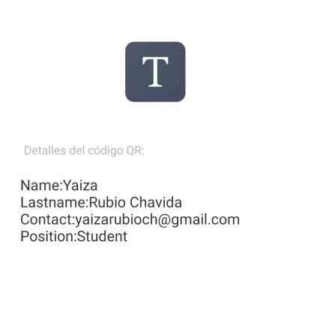
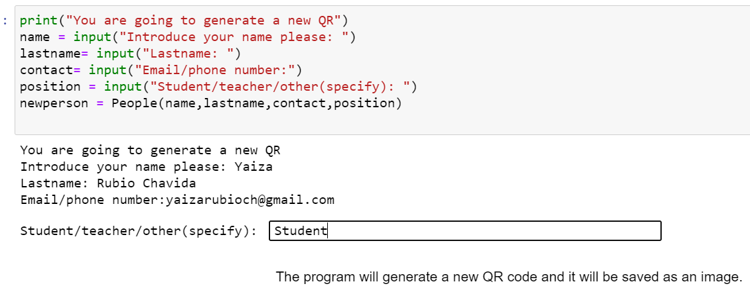
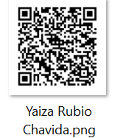
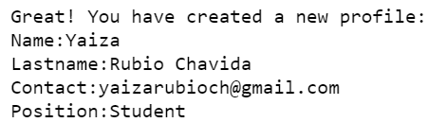
1
GENERATE A QR
Assign each person a QR code with their personal data inside

Slide 5

Compare the QR of this person with the database and give an access to the person to enter if it finds matching information.
2
Allow or deny request.
3
Decode QR to save information. Add data to the matching name (date, time, participation)

Slide 6
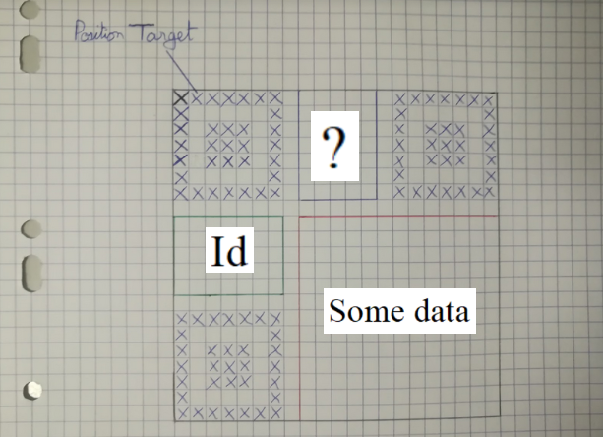
4
A TRY TO IMPlEMENT OUR OWN QR CODE SYSTEM

Slide 7
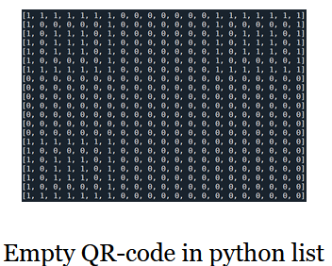
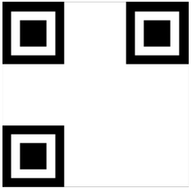
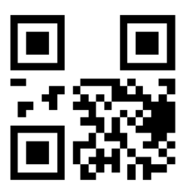
Turtle
Result obtained
Result obtained with data loaded on

Slide 8
BACKGROUND
We have looked for different programs that have been tested and we will take them as a reference to learn different things from them .
- Different examples in different languages in github . [4]
Recent report explaining how to read and generate different QR codes using python, qrtools library. [5]
Zbar library and ways to install it. [2]
Video that explains the relevant parts of the QR code, its size and discusses how much data a QR-code can hold. [6]

Slide 9
HINTS FOR FUTURE
RESEARCH
GENERATE QR AND SAVE IT AS AN IMAGE
COMPARE
SCAN QR
FROM USER MOBILE
CONTROL ACCESS
- Implement a way to scan the image in the computer
Add encryptation methods.
Connect this system with an automatic door to lock and unlock.
- Improve the admission part dividing people in different timetables.
SAVE DATA

Slide 10

FINAL CONCLUSIONS
Chosing the appropiate environment.
Analyzing the different functions of libraries.
A bit of confusion joining different parts.
SOME DIFFICULTIES
PRESENTED
Good results.
Learning objectives achieved.
Complete system almost done.
ACHIEVEMENTS

Slide 11
REFERENCES
[1] Kalebu Jordan. Become a pro python developeer (2017).
https://kalebujordan.com/reading-bar-codes-python/
[2] Adrian Rosebrock. An Open CV barcode and QR code scanner with ZBar.(2018)
https://www.pyimagesearch.com/2018/05/21/an-opencv-barcode-and-qr-code-scanner-with-zbar/
[3] Jae Hwa Chang. An introduction to using QR codes in scholarly journals. (2014)
https://www.researchgate.net/publication/271098121_An_introduction_to_using_QR_codes_in_scholarly_journals
[4] GitHub code(2020)
https://github.com/nayuki/QR-Code-generator
[5] Reading and Generating QR codes in Python using QRtools (2020)
https://www.geeksforgeeks.org/reading-generating-qr-codes-python-using-qrtools/
[6] James. How QR codes are built.(2020)
https://www.youtube.com/watch?v=142TGhaTMtI

Slide 12

THANK YOU

